Slide 1
The Network Layer – Part 4

Slide 2
Contents
Introduction to Internetworking
Concatenated Virtual Circuits
Connectionless Internetworking
Tunneling
Internetwork Routing
Fragmentation

Slide 3
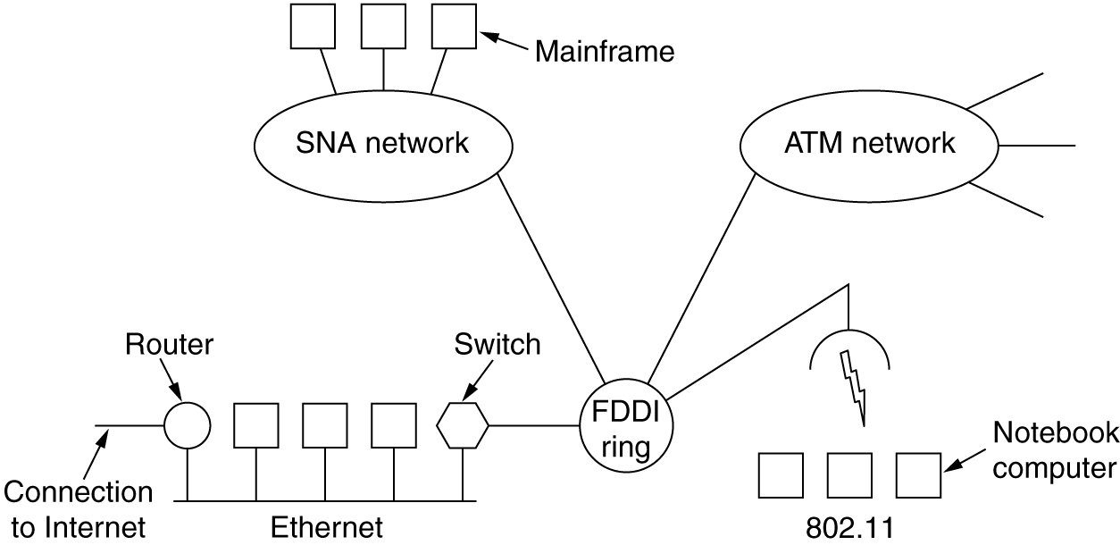
Connecting Networks
A collection of interconnected networks.

Slide 4
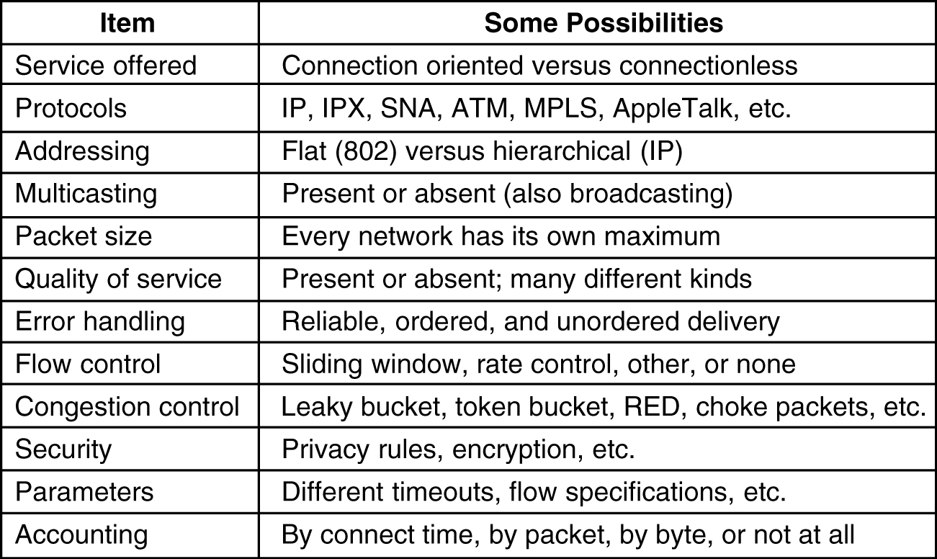
Introduction to Internetworking
The purpose of interconnecting all these networks:
  is to allow users on any of them to communicate with users on all the other ones and also to allow users on any of them to access data on any of them.
Some of the many ways networks can differ.

Slide 5
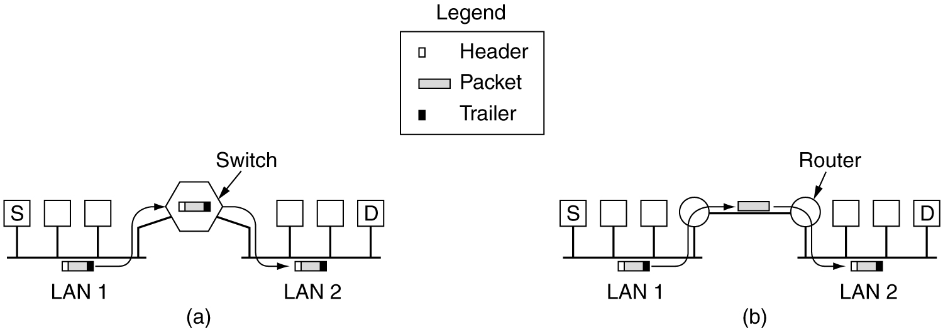
How Networks Can Be Connected
Networks can be interconnected by different devices:
  multiprotocol router: a router that can handle multiple protocols
(a) Two Ethernets connected by a switch.
(b) Two Ethernets connected by routers.

Slide 6
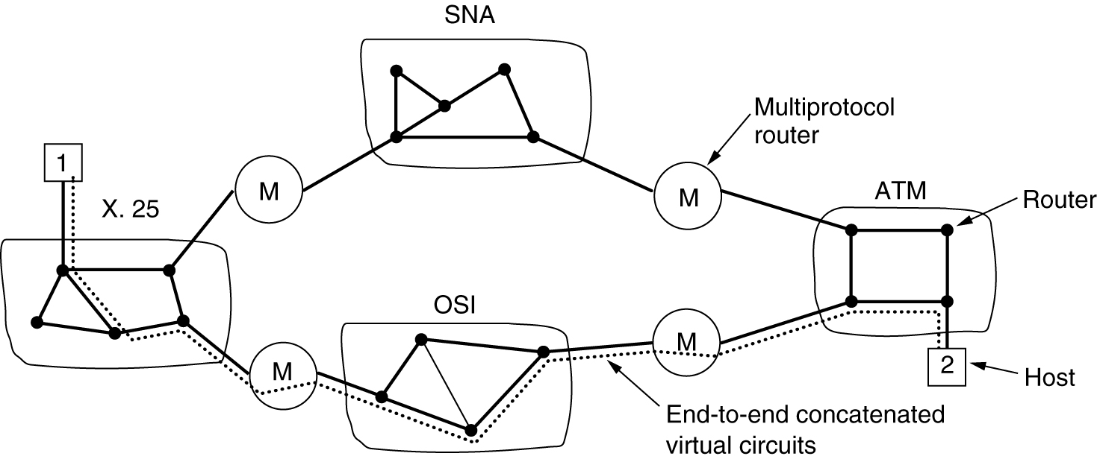
Concatenated Virtual Circuits
Internetworking using concatenated virtual circuits.

Slide 7
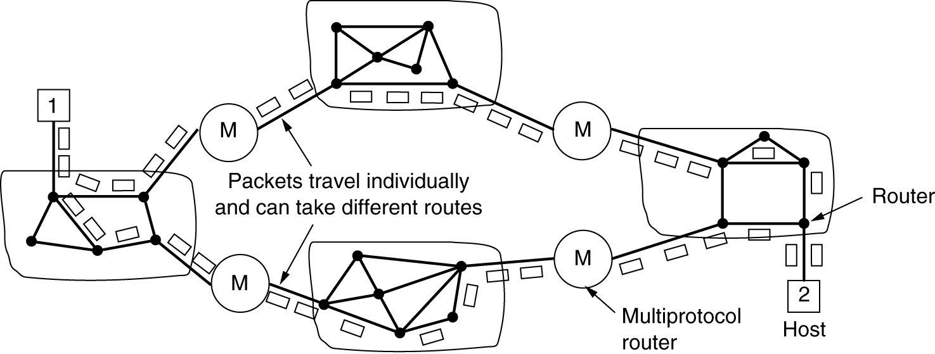
Connectionless Internetworking
A connectionless internet.

Slide 8
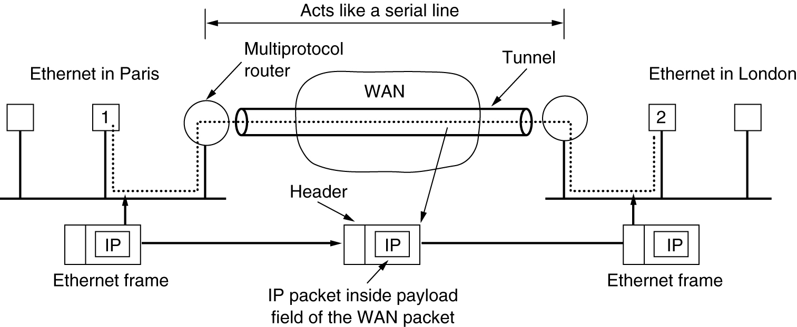
Tunneling
Tunneling a packet from Paris to London.

Slide 9
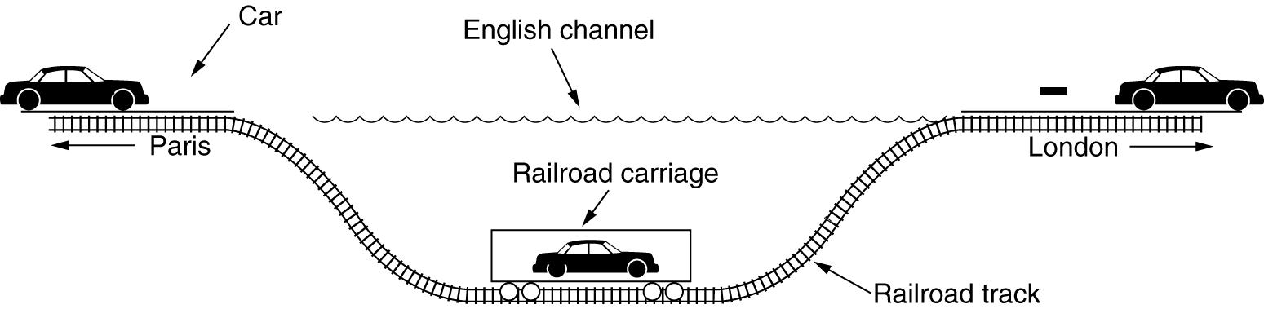
Tunneling (2)
Tunneling a car from France to England.

Slide 10
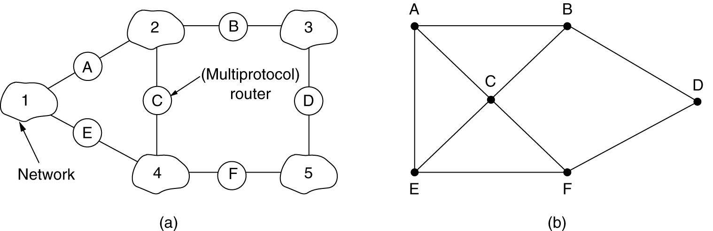
Internetwork Routing
(a) An internetwork. (b) A graph of the internetwork.
IGP：Interior gateway protocol
EGP：exterior gateway protocol
AS：Autonomous System

Slide 11
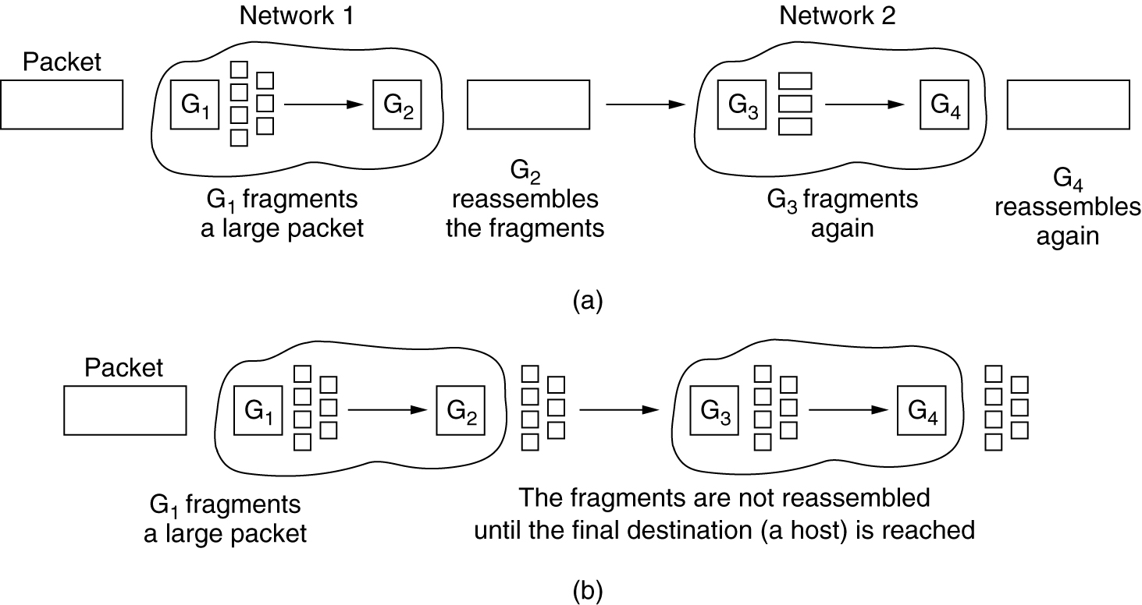
Fragmentation
(a) Transparent fragmentation. (b) Nontransparent fragmentation.

Slide 12
Summary
Internetworking
  Why?
  How:
    Concatenated Virtual Circuits, Connectionless Internetworking
    Multiprotocol router
    Tunneling
Internetwork Routing
  IGP, EGP
  AS
Fragmentation

